Slide 1
Creating Scalable Solutions with Amazon Cloud Services
Ondrej balas
@ondrejbalas  www.ondrejbalas.com  Ondrej@ondrejbalas.com →
Notes:
The icons use FontAwesome. If they appear to be missing, try installing the font from here: http://fortawesome.github.io/Font-Awesome/

Slide 2



Ondrej balas
 Husband & Father
 Microsoft MVP in C#
 Writer for Visual Studio Magazine
 Owner of UseTech Design (est. 2001)
 Building software that drives business
 www.ondrejbalas.com
→ Ondrej@ondrejbalas.com
 @ondrejbalas

Slide 3
Data Acquisition Application
Data
Source
Data
Source
Data
Source

Slide 4
Data
Source
Data
Source
Data
Source
Data
Source
Data
Source
Data
Source
Data Acquisition Application
Data
Source
Data
Source
Data
Source
Data
Source
Data
Source
Data
Source
Data
Source

Slide 5
Data
Source
Data
Source
Data
Source
Data
Source
Data
Source
Data
Source
Data Acquisition Application
Data
Source
Data
Source
Data
Source
Data
Source
Data
Source
Data
Source
Data
Source

Slide 11


Slide 14
Elastic Compute Cloud (EC2)
Infrastructure as a Service (IAAS)

Slide 15
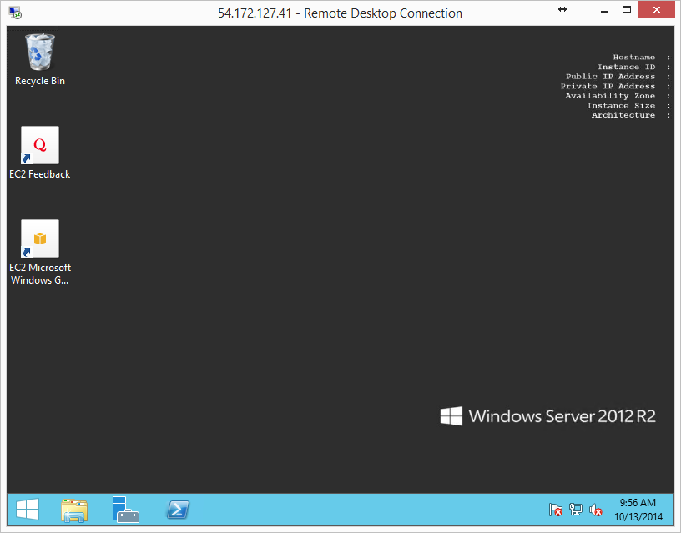

Slide 16
Virtual Machines
Provisioned within minutes
Choose your own AMI (disk image) or use a pre-existing one
Pay by the hour – as low as $0.006 per hour
Many machine sizes to choose from

Slide 17

When an EC2 Instance is created, its hard disk contents are copied from an AMI
EC2 Instance
AMI

Slide 18




When an EC2 Instance is created, its hard disk contents are copied from an AMI
EC2 Instance
AMI

Slide 19


When an EC2 Instance is created, its hard disk contents are copied from an AMI
Security Group
EC2 Instance
A security group acts as the firewall between the internet and the instance
AMI
An AMI can be created by copying the current state of an EC2 instance
Internet

Slide 20


When an EC2 Instance is created, its hard disk contents are copied from an AMI
Security Group
EC2 Instance
A security group acts as the firewall between the internet and the instance
Key Pair
AMI
An instance is assigned a key pair at creation time, and the same one must be later used to gain access to the instance.
Internet

Slide 21
Launching the Instance
DEMO – aws control panel
Notes:
Go into the AWS control panel. Create a Security Group. Create a Key Pair. Create the Instance. RDP into the pre-created Instance (like Martha Stewart, pull the cookies out of the oven). Transition point: Talk about how to make the transition into managing these things with code. To do that I will need to go into IAM. Create a User. Create a Group. Add a user to the Group.

Slide 22
Accessing Instances Programmatically
AWSCredentials credentials = new BasicAWSCredentials("AccessKey", "SecretKey");
IAmazonEC2 client = AWSClientFactory.CreateAmazonEC2Client
(credentials, RegionEndpoint.USEast1);
DescribeInstancesResponse describeInstancesResponse = client.DescribeInstances();
List<Reservation> reservations = describeInstancesResponse.Reservations;
foreach (Instance instance in reservations.SelectMany(x => x.Instances))
{
Console.WriteLine("Instance with ID {0} is currently {1}", instance.InstanceId,
instance.State.Name);
}

Slide 23
Accessing Instances Programmatically
AWSCredentials credentials = new BasicAWSCredentials("AccessKey", "SecretKey");
DescribeInstancesRequest request = new DescribeInstancesRequest();
request.Filters.Add(new Filter("instance-state-code", new List<string>() {"0", "16"}));
List<Reservation> reservations = client.DescribeInstances(request).Reservations; List<Reservation> reservations = client.DescribeInstances().Reservations;
foreach (Instance instance in reservations.SelectMany(x => x.Instances))
{
Console.WriteLine("Instance with ID {0} is currently {1}", instance.InstanceId,
instance.State.Name);
}
State codes
0 pending
16 running
32 shutting-down
48 terminated
64 stopping
80 stopped

Slide 24
Instrumentation
Demo - Managing instances across the globe
Notes:
This very simple code can be powerful. I’ve created a dashboard where I can see my instances across the globe.

Slide 27
Worker Service
Installed onto my Base AMI
Updateable from the Instrumentation
Uses WebAPI Selfhost to manage requests
And TopShelf to make it a service

Slide 28
Moving Bits Around
There’s more to it than just scaling servers up and down

Slide 29


SQS (Simple Queue Service)
Publishers
Queue
Consumer
Publishers send messages to the queue
Consumer periodically checks the queue for messages

Slide 30
SQS (Simple Queue Service)
Publishers
Queue
Consumers
Publishers send messages to the queue
Consumers take messages from the queue and process them in parallel

Slide 31
SQS (Simple Queue Service)
Consumers & Publishers
Final Consumer
Publishers
Queue
Queue

Slide 32
SQS (Simple Queue Service) Writing to a queue
AmazonSQSClient client = new AmazonSQSClient(credentials, RegionEndpoint.USEast1);
string message = "my message";
string queueUrl = "https://sqs.us-east-1.amazonaws.com/025631894481/aws-talk";
SendMessageResponse sendMessageResponse = client.SendMessage(queueUrl, message);

Slide 33
SQS (Simple Queue Service) Reading from a queue
AmazonSQSClient client = new AmazonSQSClient(credentials, RegionEndpoint.USEast1);
string queueUrl = "https://sqs.us-east-1.amazonaws.com/025631894481/aws-talk";
ReceiveMessageResponse response = client.ReceiveMessage(queueUrl);
foreach (Message message in response.Messages)
{
// Do something with the message
client.DeleteMessage(queueUrl, message.ReceiptHandle);
}

Slide 34
SQS (Simple Queue Service) Reading from a queue
AmazonSQSClient client = new AmazonSQSClient(credentials, RegionEndpoint.USEast1);
string queueUrl = "https://sqs.us-east-1.amazonaws.com/025631894481/aws-talk";
ReceiveMessageRequest request = new ReceiveMessageRequest(queueUrl);
request.MaxNumberOfMessages = 1;
ReceiveMessageResponse response = client.ReceiveMessage(request);
foreach (Message message in response.Messages)
{
// Do something with the message
client.DeleteMessage(queueUrl, message.ReceiptHandle);
}

Slide 35
SQS – Important Notes
Messages are not guaranteed to be delivered in order
In rare circumstances, messages can be delivered more than once
Dead letter queues can be created, allowing failed items to be automatically moved after some number of failures

Slide 36




SNS (Simple Notification Service)
Publishers
Topic
Consumers
Publishers send messages to the topic
Consumers receive all messages sent to the topic

Slide 37
SNS (Simple Notification Service)
Publishers
Topic
SQS Queue
Consumers
Publishers send messages to the topic
All consumers receive all messages sent to the topic

Slide 38
SNS (Simple Notification Service)
Messages are not requested, they are pushed to subscribers
Subscribers are just endpoints
Endpoints can be: HTTP, HTTPS, Email, Email-JSON, SMS, SQS

Slide 39
Storing Data
Lots of ways to do it

Slide 40
S3 (Simple Storage Service)
Like a simple key-value store
Great for storing files
Store up to 5TB per object
Extremely scalable and durable
Highly available

Slide 41
Glacier
Similar to S3
Meant for archival – long term storage is durable and cheap
From the Glacier website: “Glacier is designed with the expectation that retrievals are infrequent and unusual, and data will be stored for extended periods of time. You can retrieve up to 5% of your average monthly storage (pro-rated daily) for free each month. If you choose to retrieve more than this amount of data in a month, you are charged a retrieval fee starting at $0.01 per gigabyte.”
Source: http://aws.amazon.com/glacier/pricing/

Slide 42
Database Solutions
SimpleDB
DynamoDB
RDS (Managed Relational Database Service)

Slide 43

Pricing
Estimating it can be difficult
“Fixed” costs such as instance-hours or gigabyte-months aren’t too bad
Requests are counted in “Cost per million”
And then factor in bandwidth, too.
Usually ends up being really cheap!

Slide 44
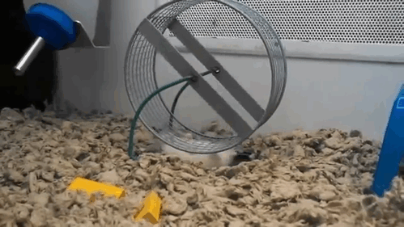
So Many Services to Choose From

Slide 45
Thanks!
 tinyurl.com/obalas-aws
 github.com/ondrejbalas
Ondrej balas
@ondrejbalas  www.ondrejbalas.com  Ondrej@ondrejbalas.com →

